Slide 1
1:1-11

Slide 2
1:1-11
know, knowledge, etc. ~ 15x in 3 chapters
ginoskō ~ v. to know
epiginoskō ~ v. to know experientially
gnosis ~ n. knowledge

Slide 3
1:1-11

Slide 4
1:1-11
2 Peter 1:1–11 ~ ¹ Simon Peter, a bondservant and apostle of Jesus Christ,
To those who have obtained like precious faith with us by the righteousness of our God and Savior Jesus Christ:
² Grace and peace be multiplied to you in the knowledge of God and of Jesus our Lord, ³ as His divine power has given to us all things that pertain to life and godliness, through the knowledge of Him who called us by glory and virtue, ⁴ by which have been given to us exceedingly great and precious promises,

Slide 5
1:1-11
2 Peter 1:1–11 ~ that through these you may be partakers of the divine nature, having escaped the corruption that is in the world through lust.
⁵ But also for this very reason, giving all diligence, add to your faith virtue, to virtue knowledge, ⁶ to knowledge self-control, to self-control perseverance, to perseverance godliness, ⁷ to godliness brotherly kindness, and to brotherly kindness love. ⁸ For if these things are yours and abound, you will be neither barren nor unfruitful in the knowledge of our Lord Jesus Christ.

Slide 6
1:1-11
2 Peter 1:1–11 ~ ⁹ For he who lacks these things is shortsighted, even to blindness, and has forgotten that he was cleansed from his old sins.
¹⁰ Therefore, brethren, be even more diligent to make your call and election sure, for if you do these things you will never stumble; ¹¹ for so an entrance will be supplied to you abundantly into the everlasting kingdom of our Lord and Savior Jesus Christ.

Slide 7
1:1-11

Slide 8
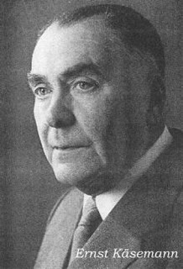
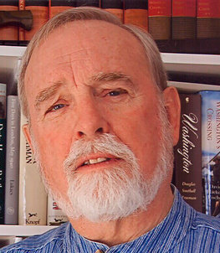
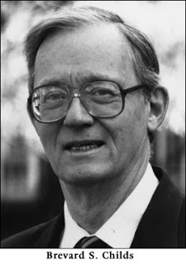
1:1-11
Ernst Käsemann (1906 – 1998) ~ “perhaps the most dubious writing in the New Testament.”
Stephen L. Harris (b. 1937) ~ “Virtually none believe that 2 Peter was written by Jesus’ chief disciple.”
Brevard S. Childs (1923-2007) ~ “Even among scholars who recognize the non-Petrine authorship there remains the sharpest possible disagreement on a theological assessment.”

Slide 9
1:1-11

Slide 10
1:1-11
Great fire of Rome AD 64
Peter’s martyrdom c. AD 68
1st persecution of Christians
AD 63
AD 64
AD 65
AD 66
AD 67
AD 68
1 Peter written c. AD 65-66
2 Peter written c. AD 67

Slide 11
1:1-11
External issues: tribulation; persecution
1 Peter
Internal issues: false teaching; doctrine
2 peter

Slide 12
1:1-11
Gnosticism ~ from ginoskō – to know
Platonic philosophy, pagan mythologies and New Testament allegorizing
Physical creation was inherently evil
Biblical God was considered inferior
Gnostic “savior” brought “knowledge” and “enlightenment” to free men from enslavement to material world

Slide 13
1:1-11

Slide 14
1:1-11
Lev. 21:5-6 ~ ⁵ But if the servant plainly says, “I love my master, my wife, and my children; I will not go out free,” ⁶ then his master shall bring him to the judges. He shall also bring him to the door, or to the doorpost, and his master shall pierce his ear with an awl; and he shall serve him forever.

Slide 15
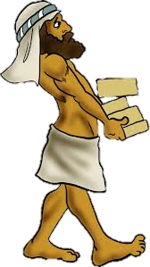
1:1-11
GOD
doulos – the permanent relation-
ship to the Master
hupēretēs – the inferiority of the worker
diakonos – the menial aspects
of the work
3 words for Christian service

Slide 16
1:1-11
bondservant ~ doulos

Slide 17
1:1-11

Slide 18
1:1-11
KJV ~ righteousness of God and our Savior Jesus Christ
NASB ~ righteousness of our God and Savior, Jesus Christ
NLT ~ Jesus Christ, our God and Savior

Slide 19
1:1-11

Slide 20
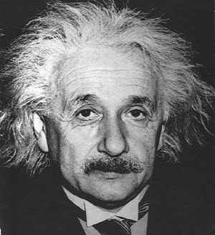
1:1-11
Albert Einstein (1879-1955) ~ “Information is not knowledge.”
1000111 1001111 1000100
G O D L O V E S Y O U
1001100 1001111 1010110 1000101 1010011
1011001 1001111 1010101

Slide 21
1:1-11
1 Cor. 8:1~ Now concerning things offered to idols: We know that we all have knowledge. Knowledge puffs up, but love edifies.
2 Pet. 2:21 ~ For it would have been better for them not to have known the way of righteousness, than having known it, to turn from the holy commandment delivered to them.

Slide 22
1:1-11

Slide 23
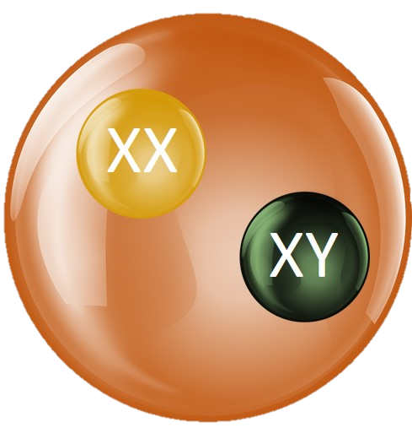
1:1-11
XX
XY
Egg
Sperm
This Photo by Unknown Author is licensed under CC BY-SA

Slide 24
1:1-11

Slide 25
1:1-11
has given ~ perfect tense
Describes an action which is viewed as having been completed in the past, once and for all, not needing to be repeated

Slide 26
1:1-11

Slide 27
1:1-11
2 Cor. 3:18 ~ But we all, with unveiled face, beholding as in a mirror the glory of the Lord, are being transformed into the same image from glory to glory, just as by the Spirit of the Lord.
John 3:3 ~ Jesus answered and said to him, “Most assuredly, I say to you, unless one is born again, he cannot see the kingdom of God.”
anōthen ~ again and from above

Slide 28
1:1-11

Slide 29
1:1-11
John 14:6 ~ I am the way, the truth, and the life. No one comes to the Father except through Me.

Slide 30
1:1-11

Slide 31
1:1-11
diligence ~ spoudē – from word meaning to make haste
virtue ~ fulfilling that which it was designed for
NIV, goodness

Slide 32
1:1-11
knowledge ~ processed information
self-control ~ from two words meaning “in vigor”
perseverance ~ hupomonē – to keep on keeping on
godliness ~ to have a vertical focus behind our behavior

Slide 33
1:1-11
brotherly kindness ~ philadelphia
NLT, brotherly affection
love ~ agape – unconditional love

Slide 34
1:1-11
FAITH
VIRTUE
LOVE
KNOWLEDGE
GODLINESS
BROTHERLY
KINDNESS
SELF-CONTROL
PERSEVERANCE

Slide 35
1:1-11
FAITH
VIRTUE
LOVE
KNOWLEDGE
GODLINESS
BROTHERLY
KINDNESS
SELF-CONTROL
PERSEVERANCE

Slide 36
1:1-11
FAITH
VIRTUE
LOVE
KNOWLEDGE
GODLINESS
BROTHERLY
KINDNESS
SELF-CONTROL
PERSEVERANCE

Slide 37
1:1-11
SELF-CONTROL
PERSEVERANCE
KNOWLEDGE
GODLINESS
VIRTUE
BROTHERLY
KINDNESS
FAITH
LOVE
growth-o-meter

Slide 38
1:1-11

Slide 39
1:1-11
knowledge
Bible
obedience
= growth

Slide 40
1:1-11

Slide 41
1:1-11
WE
CAN
LOSE
OUR
SALVATION!!!!
CAN
NOT
LOSE
SALVATION????
WE
OUR

Slide 42
1:1-11

